Slide 1
Continuous Sign Language Recognition through Cross-Modal Alignment of Video and Text Embeddings in a Joint-Latent Space
Guide:
Dr. Atluri Srikrishna,
HOD, IT Department,
RVR & JC College of Engineering
Presented By:
Y17IT035 - G. Naga Phani Sreevatsava
Y17IT041 - I. Pavan Kalyan
Y17IT052 - K. Siva Naik

Slide 2

Problem Statement
Continuous Sign Language Representation (CSLR) refers to the challenging problem of recognizing sign language glosses and their temporal boundaries form weakly annotated video sequences.

Slide 3
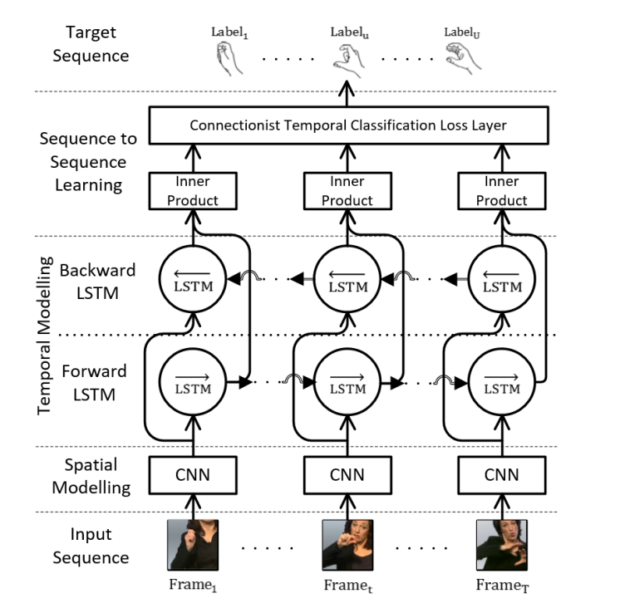
Related Work
SubUNets: End-to-end Hand Shape and Continuous Sign Language Recognition.

Slide 4
Proposed Model
The video encoder consists of
A CNN for spatial feature extraction.
Stacked 1D-Temporal Convolutional Networks for short-term temporal modelling.
A bi-directional LSTM units for context learning.
A text encoder is implemented using a unidirectional LSTM to model the sequences of sign language glosses.
An overview of proposed architecture is shown in the next slide.

Slide 5
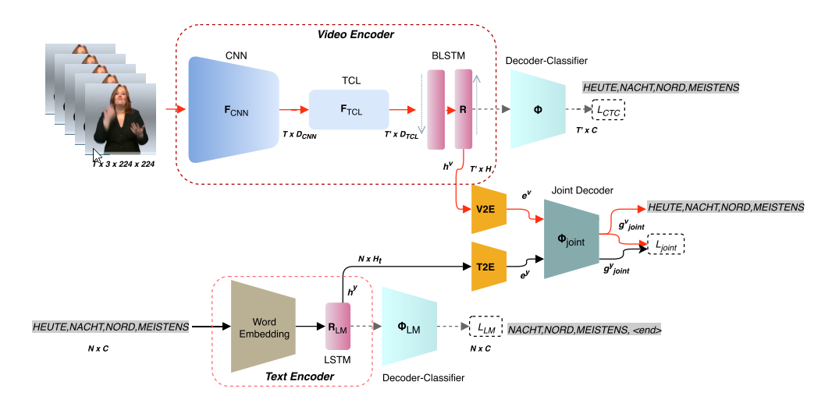
Overview of the proposed method

Slide 6
Tools Used
Matplotlib – For plotting graphs and displaying images.
TensorFlow – A framework to implement Neural Network Architectures easily.
PyTorch – A Deep Learning framework used to easily create custom Layers for the models.
Google CoLab – A cloud based interactive python notebook used to train the model.

Slide 7
Video Encoder
The proposed video encoder adopts a 2D-CNN followed by temporal convolution layers to extract spatiotemporal features from the input video.
The extracted features are then processed through a BLSTM layer to learn long-term dependencies over all timesteps.
The video encoder consists of two parts
Feature Extraction
Sequence Modelling

Slide 8
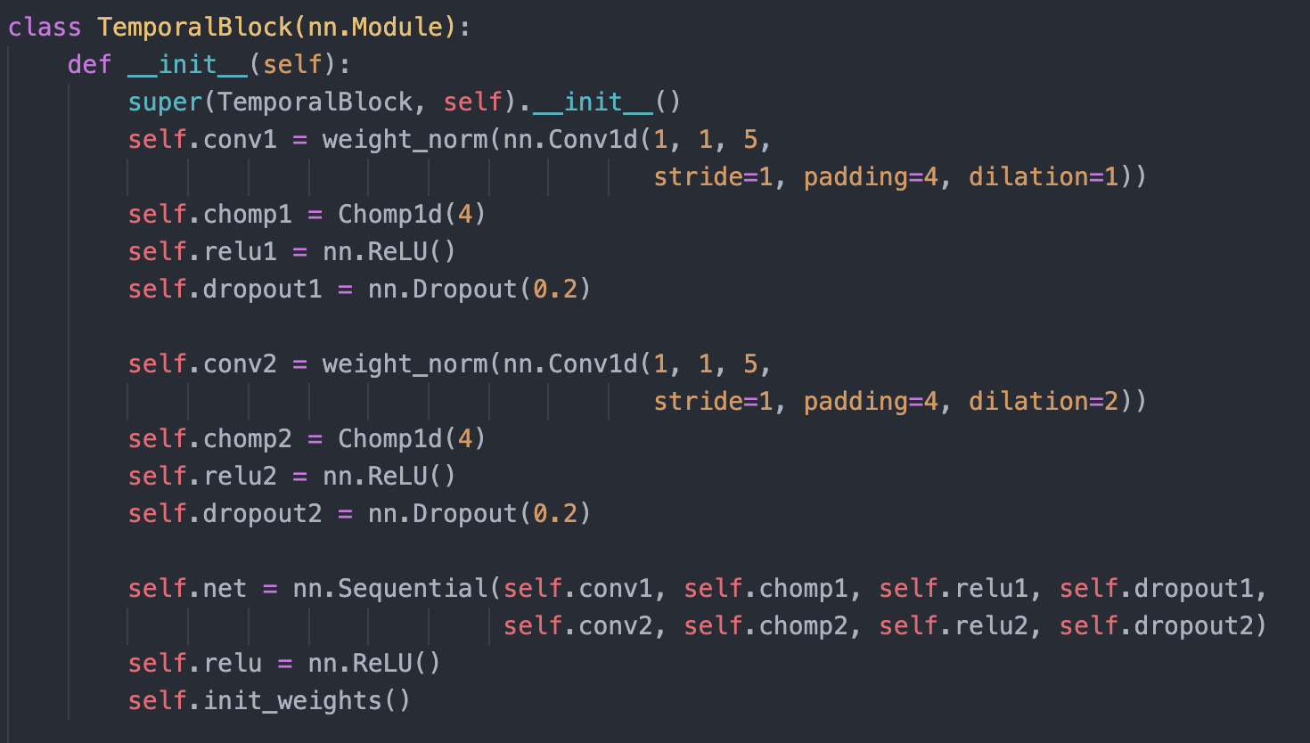
Temporal CNN Implementation

Slide 9
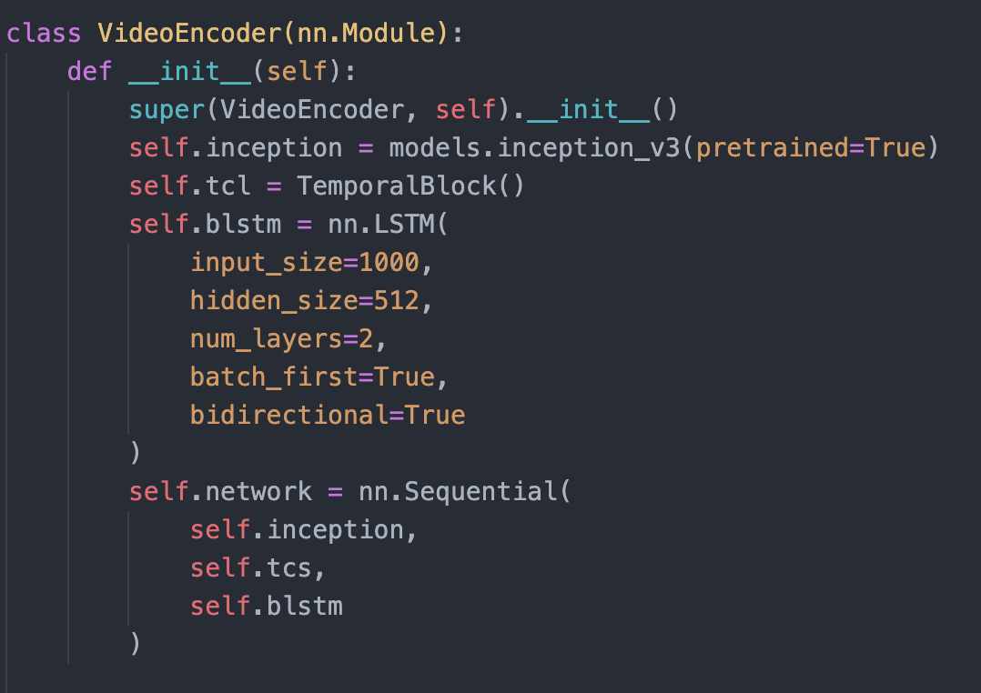
Video Encoder

Slide 10
Text Encoder
The proposed Text Encoder is a RNN Language Model, that models the probability of a word occurrence of under the condition of its previous words in a sentence.
It aims to learn the structure and syntax of the sign language.
The model maximizes the log-likelihood of the target sentence given the hidden states and the previous words.
The text encoder employs a word embedding layer and a LSTM layer with H_{text} hidden units.

Slide 11
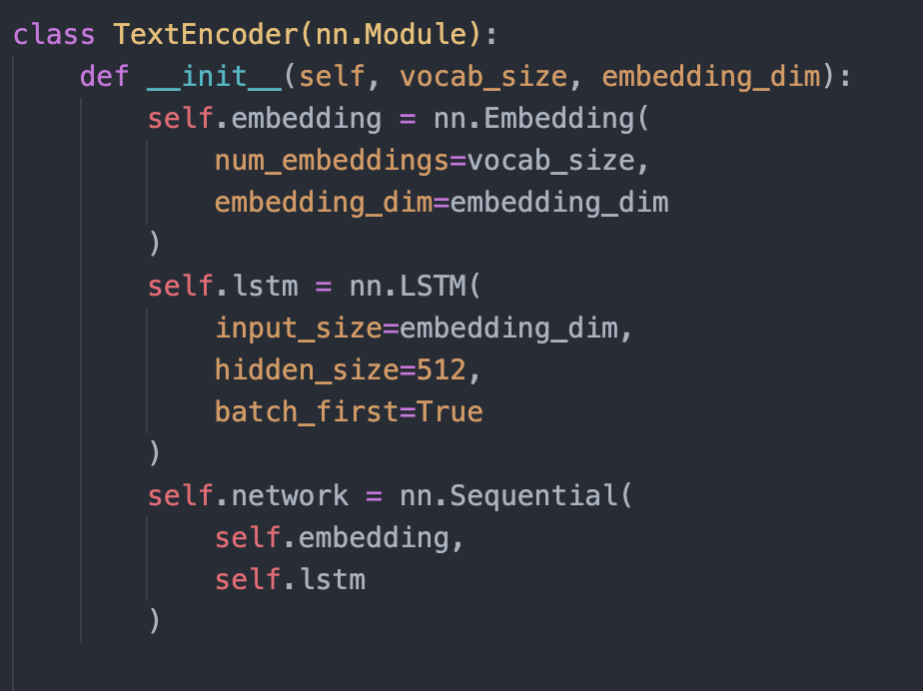
Text Encoder Implementation

Slide 12
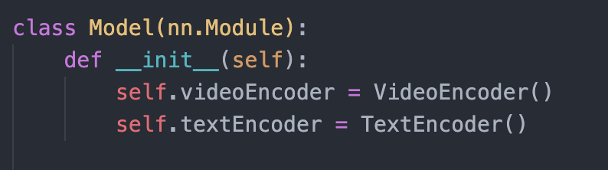
Final Model

Slide 13
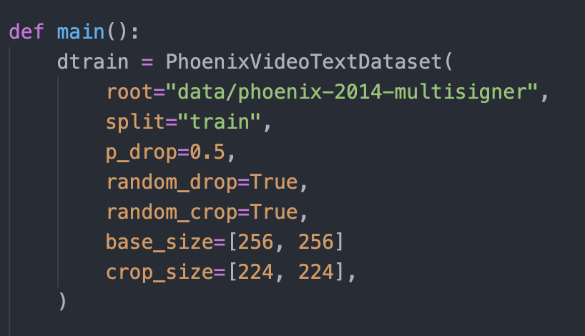
Loading Phoneix Weather Dataset

Slide 14
Optimization
The proposed framework employs a CTC loss function to train
The video encoder given the frame sequence and
The joint decoder given the video latent space representations.
The objective of using the CTC loss is to maximize the sum of probabilities of all possible mappings between input and target sequences.
CTC extends the vocabulary C with a blank label ‘‘−", representing the silence or transition between two consecutive labels.
The extended vocabulary can be defined as V = C ∪ {blank}.

Slide 15
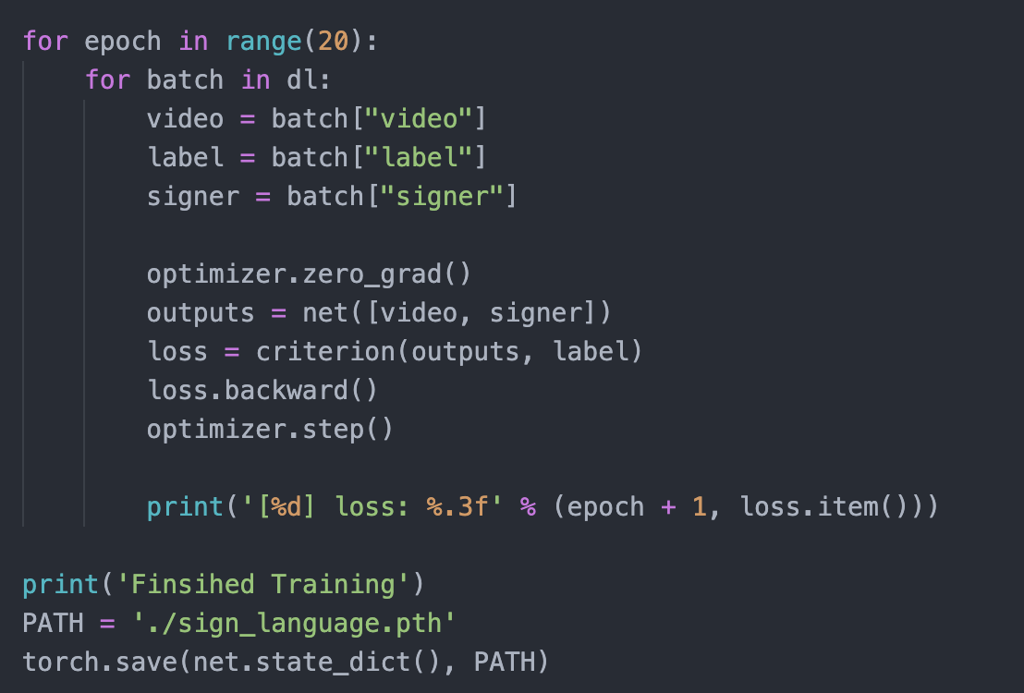
Final Training

Slide 16
Implementation
For the proposed video encoder, a 2D-CNN (BN-Inception) network is used that is initialized with weights pretrained on the ImageNet dataset.
The kernel and stride sizes of the TCL module are manually tuned to approximately cover the average gloss duration.
TCL has two 1D convolutional layers with 1024 filters and two max-pooling layers.
The BLSTM layer consists of 2 LSTMs with 512 hidden units each.
The text encoder has 1 LSTM layer with 512 hidden units.

Slide 17
Implementation (contd.)
The data processing techniques are used for all the datasets used for evaluation.
Each frame is resized to 256 × 256 and cropped at a random position to a fixed size of 224×224.
Random temporal frame sampling is used up to 80% of video length.
Brightness, contrast, saturation and hue values of frames are randomly jittered up to 10%.
The full architecture is trained with Adam optimizer with an initial learning rate 0.00005
Long videos are down-sampled to a maximum length of 250 frames, if necessary.

Slide 18
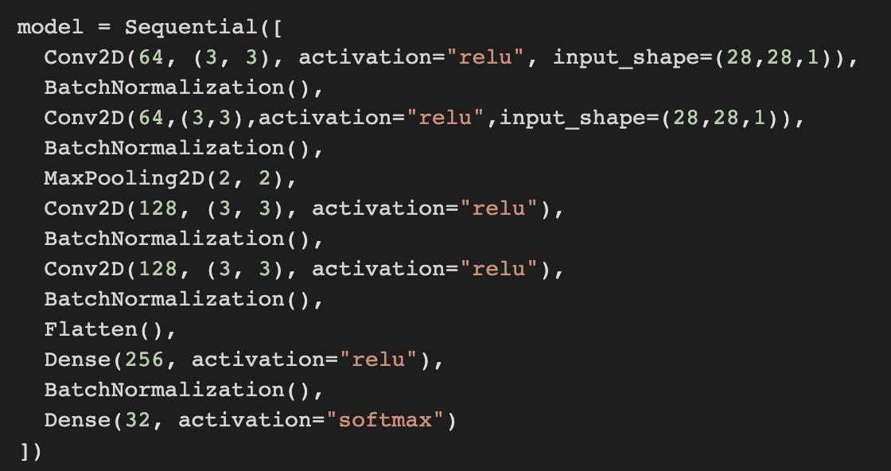
Implementation of SLR

Slide 19
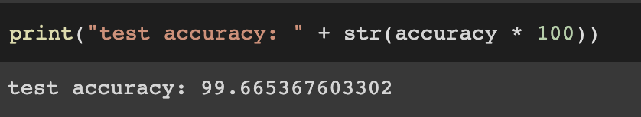
Results for SLR

Slide 20
Conclusion
Implemented the Deep Learning Architecture for the proposed model.
Trained a sample SLR model with static images.
Got the test accuracy of 99.66%

Slide 21
Thank You

